Slide 1

CSCI 599: Content Detection and Analysis of Big Data : Class Activity(Named Entity Recognition)
Presentation by:
Dhairya Pujara
Pavneet Kaur Mukar
Sachin Kumar GB
Sanjay Nadhavajhala
Vinita Thakur

Slide 2
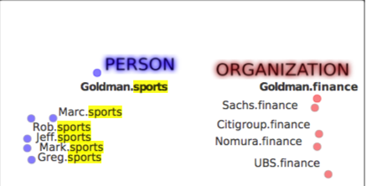
SPORTS
Named Entities | Examples
People, places, boards, organizations, teams, sport, venues | Places : LA, Liverpool, Manchester People : Steven Gerrard, Kobe Bryant Boards : BCCI, FA Organizations : NBA, MLS, La Liga Teams : Liverpool FC, LA Galaxy Sport : Football, Cricket, Soccer, Tennis
Parsing?
Having background knowledge about the sport always helps in terms of identifying the context. In addition to this language rules, sentence structure can be used to identify named entities.
Example : Cricket – “crease”, “field”, “wicket”, “boundary”.
Notes:
What named entities are discernable?
People, place, boards, teams organization
Parsing?
Simple parsing using language rules is sufficient, in addition to that it helps to have a mapping to an exisiting comprehension of existing sport related entities

Slide 3
LOGISTICS
Named Entities | Examples
People, Location, Vehicle, Organization, Parcel | Location : Receiver’s Address, Items Warehouses People : (Sender’s, Receiver’s, Driver’s) Name Vehicle : Van, Truck, Car Organization : UPS, FedEx, DHL Parcel : Gifts, Home Appliances, Flowers
Parsing?
Logistic data is generally structured (Relational Database) or in NoSQL format (JSON, XML) and easy to parse
XML, JSON parsing capability supported in almost all programming languages
Online parsing tools are also available
Notes:
What named entities are discernable?
People, place, boards, teams organization
Parsing?
Simple parsing using language rules is sufficient, in addition to that it helps to have a mapping to an exisiting comprehension of existing sport related entities

Slide 4
RESTAURANTS
Named Entities | Examples
People, Organizations, Places, Dishes, Quantities, Monetary Values | People : Usernames on Yelp/TripAdvisor/Foursquare Organizations : Panda Express, Fat Burger, Five Guys Places : Los Angeles, San Francisco Dishes : Orange Chicken, Eggplant Tofu, Lemon Truffle Quantities : 2 pieces, 6 portions, Serves 4 Monetary values : $12, $6, $8.5
Parsing?
Straightforward parsing : Usernames (from the database of usernames), Organizations, Places
Places if part of a review would require gazetteers
Dishes, Quantities, if part of an image would require OCR
Monetary values can be found out by trying to look for numbers in a particular range

